Slide 1
Logic
Rachel Cavill

Slide 2
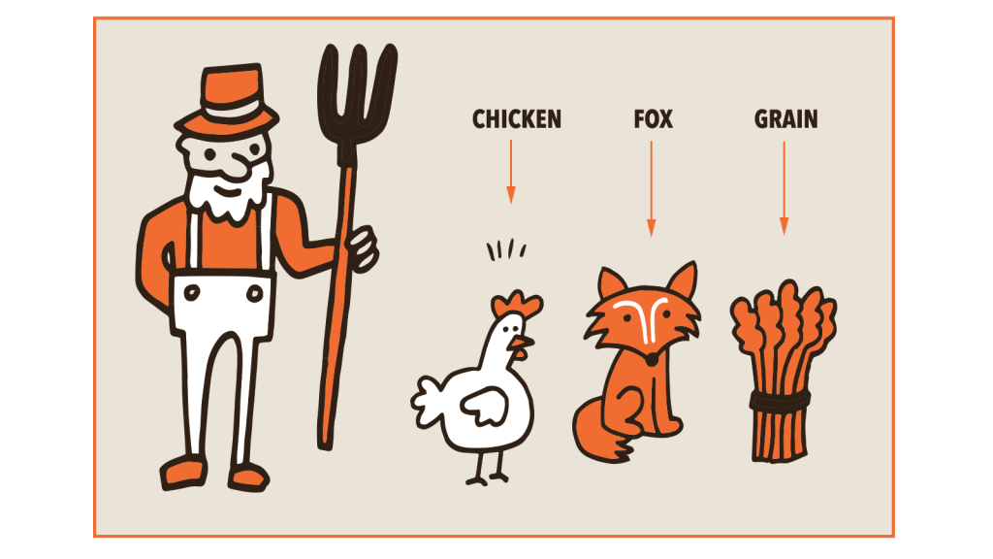
Farmer crossing river puzzle
The farmer needs to take his chicken, fox and grain across the river.
In his boat he can only carry 1 thing at a time
If he leaves the chicken with the grain it will eat it
If he leaves the fox with the chicken it will get eaten.
Describe this environment
Make a search tree to solve this puzzle

Slide 3
Environment description
Fully Observable
Single Agent
Deterministic
Sequential
Static
Discrete

Slide 4
Notation for solutions
We will call the two sides of the river west (w) and east (e)
Everything starts on the west side. [ w w w w ]
The first item in the list is the farmer, then the fox, chicken and grain in that order.

Slide 5
Search tree
[ w w w w ]
[ e e w w ]
[ e w e w ]
[ e w w e ]
[ e w w w ]
Fox eats chicken and chicken eats grain
Chicken eats grain
Fox eats chicken
[ w w e w ]
[ w w w w ]
Cycle, back to start position
[ e w e w ]
[ e e e w ]
Cycle
[ e w e e ]
[ w w e w ]
[ w e e w ]
[ w w e e ]
[ w w w e ]
[ w w e w ]
[ w e w w ]
Fox eats chicken
Chicken eats grain
Cycle
Cycle
[ e e e w ]
[ e e w e ]
[ e e w e ]
[ e w e e ]
[ e w w e ]
[ e e w w ]
Fox eats chicken
Cycle
Chicken eats grain
Cycle
[ w w w e ]
[ w e w w ]
[ w e w e ]
[ w w w e ]
[ w e w w ]
[ w e w e ]
Cycle
Cycle
[ e e e e ]
[ e e e e ]

Slide 6
PROLOG – a programming language with built-in search
In PROLOG, a logic programming language we don’t need to program the computer to build and search the tree
This is built-in to the interpreter.
Instead we just need to define the problem in a way which it understands.

Slide 7
Prolog basics
In Prolog variables begin with capital letters.
Prolog constants begin with small letters.
Prolog statements can be facts;
mother(rachel, ann). Ann is Rachel’s mother.
Or rules;
mother(X, Y) :- mother(A, Y), sister(A, X).
The mother of A is the mother of X if A is the sister of X.
Prolog functions can have multiple rules, the search algorithm tries them all in order.

Slide 8
A simple example
hold_party(X):-
birthday(X), happy(X).
birthday(tom).
birthday(fred).
birthday(helen).
happy(mary).
happy(jane).
happy(helen).
First we have a rule. hold_party is true if we can find a variable (person) who both has a birthday and is happy.
Then we have facts. A list of 3 people with birthdays and 3 people who are happy.
If we ask prolog;
hold_party(Who).
It will try to find a variable such that the hold_party rule is true for that variable.
First it will try tom, but tom isn’t listed as happy. So then it will backtrack up the search tree and try fred and finally helen, which it will return as the answer.
https://swish.swi-prolog.org/p/BirthdayDKE.pl
Example from https://www.doc.gold.ac.uk/~mas02gw/prolog_tutorial/prologpages/search.html

Slide 9
Back to Crossing the river
We use the same basic list as before, start with [w w w w] and try to get [e e e e]
First we define a crossing
crossing(e, w).
crossing(w, e).
Then we can define moves;
move([X, X, Hen, Grain], fox, [Y, Y, Hen, Grain]) :- crossing(X,Y).
This will move the fox across the river with the farmer

Slide 10
Crossing the river in Prolog
If we define all 4 valid moves we get;
crossing(e,w). crossing(w,e). move([X,X,Hen,Grain],fox,
[Y,Y,Hen,Grain]) :- crossing(X,Y). move([X,Fox,X,Grain],hen,
[Y,Fox,Y, Grain]) :- crossing(X,Y). move([X,Fox,Hen,X],grain,
[Y,Fox,Hen,Y]) :- crossing(X,Y). move([X,Fox,Hen,Grain],nothing,
[Y,Fox,Hen,Grain]) :- crossing(X,Y).

Slide 11
Checking moves are allowed…
The idea is that if at least one of the hen or the fox is on the same bank as the farmer, AND if at least one of the hen or grain is on the same side as the farmer, then the configuration is safe.
oneEq(X,X,_). oneEq(X,_,X).
safe([Farmer,Fox,Hen,Grain]) :- oneEq(Farmer,Fox,Hen),oneEq(Farmer,Hen,Grain).

Slide 12
Instructing PROLOG to solve it
We need to tell Prolog what a solution looks like
If everyone is on the east bank then it is solved:
solution([e,e,e,e],[]).
Otherwise we need to find some moves;
solution(Config,[Move|OtherMoves]) :- move(Config,Move,NextConfig),
safe(NextConfig), solution(NextConfig,OtherMoves).
Thanks to https://cseweb.ucsd.edu/classes/fa09/cse130/misc/prolog/goat_etc.html

Slide 13
Running the program
We can run the program using an online prolog interpretor like SWISH;
https://swish.swi-prolog.org/p/FarmerRiverDKE.pl

Slide 14
Facts and Rules
Prolog works by declaring the facts and the rules of the problem. This is the knowledge base.
Prolog then uses a built-in search algorithm to try to find whether a statement you ask is true or false, and if true, how it is true. This is the inference engine.
Eg. For the river crossing, we ask Prolog if everyone can be on the east side the river, based on the facts and rules we have given it, and it tells us the moves necessary to get everyone on that side of the river.

Slide 15
Propositional logic
When we ask Prolog if hold_party(helen) is true, it is looking for whether two facts hold. birthday(helen) and happy(helen).
Formally we write this as
birthday(helen) ∧ happy(helen)
If we wanted to hold a party for Helen if it was her birthday or she was happy, we would write.
birthday(helen) ∨ happy(helen)

Slide 16
More propositional logic
If Helen will be happy because it is her birthday we write;
birthday(helen) ⇒ happy(helen)
If Helen is only ever happy on her birthday;
birthday(helen) ⇔ happy(helen)
If we want to say it isn’t Helen’s birthday;
¬birthday(helen)

Slide 17
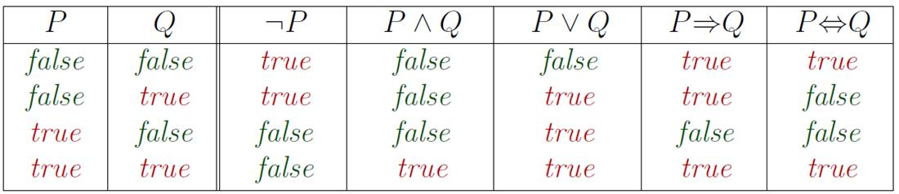
Truth Tables for Connectives

Slide 18
Entailment
Entailment means that one thing follows from another: KB ╞ α Knowledge base KB entails sentence α if and only if, in all worlds where the KB is true, α is true
E.g., the KB containing “the Giants won” and “the Reds won” entails “The Giants won or the Reds won” E.g., x+y = 4 entails 4 = x+y hold_party(helen) ╞ happy(helen)

Slide 19
Entailment
Entailment is different from the other logical operators you’ve seen so far.
The other operators can be true in one world and false in another
eg. A ∧ B is true when A is True, but not true when A and B are both false.
Entailment is different – either something entails in ALL worlds, or none.

Slide 20
Exercise
Which of the following are correct?
A ∧ B ╞ A ⇔ B
A ⇔ B ╞ A ∨ B
A ⇔ B ╞ ¬A ∨ B

Slide 21
Exercise (1)
A ∧ B ╞ A ⇔ B ?
Only in world 1 is the knowledge base true.
α is true in worlds 1 and 4.
It entails as {1} ⊆ {1,4}
Worlds | A | B | KB: A ∧ B | α: A ⇔ B
1 | T | T | T | T
2 | T | F | F | F
3 | F | T | F | F
4 | F | F | F | T

Slide 22
Exercise (2)
A ⇔ B ╞ A ∨ B?
The knowledge base is true in worlds 1 and 4.
α is true in worlds 1,2 and 3.
It does not entail as {1,4} ⊆ {1,2,3}
Worlds | A | B | KB: A ⇔ B | α: A∨B
1 | T | T | T | T
2 | T | F | F | T
3 | F | T | F | T
4 | F | F | T | F

Slide 23
Exercise (3)
A ⇔ B ╞ ¬A ∨ B
Worlds 1 and 4 are consistent with the knowledge base. Worlds 1, 3 and 4 are consistent with α.
So it entails as {1,4} ⊆ {1,3,4}.
Worlds | A | B | KB: A ⇔ B | α: ¬A∨B
1 | T | T | T | T
2 | T | F | F | F
3 | F | T | F | T
4 | F | F | T | T

Slide 24
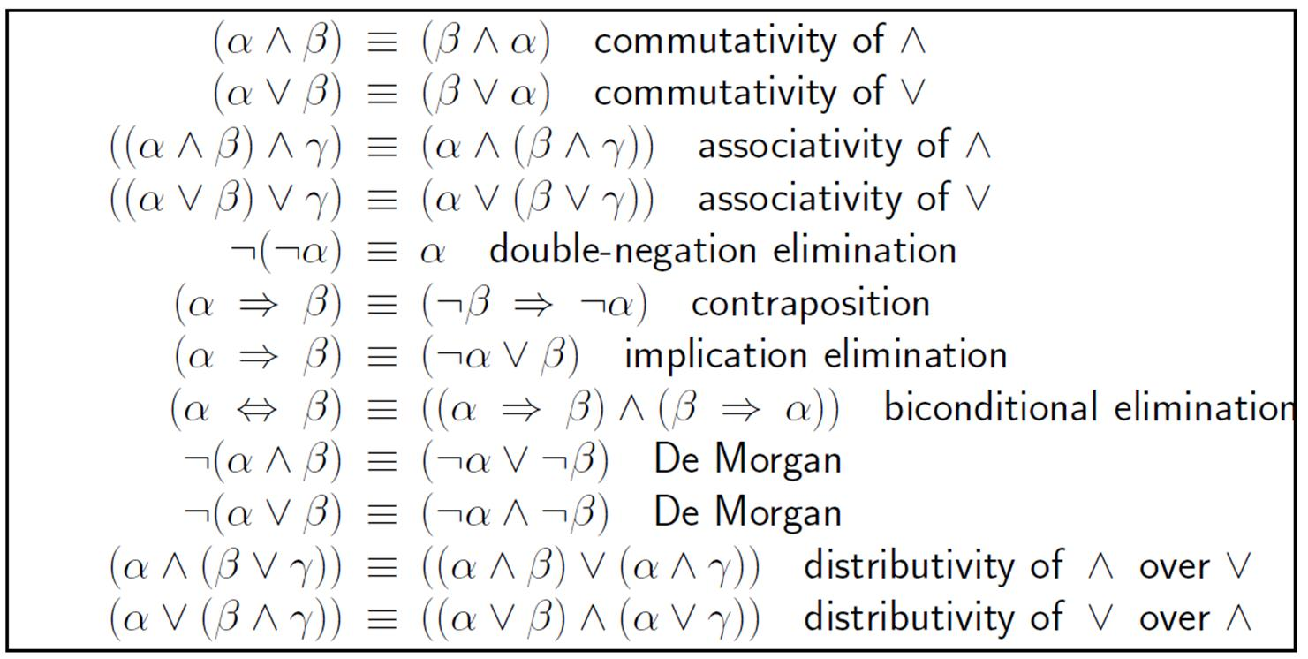
Logical Equivalence
Two sentences are logically equivalent iff true in same models: α ≡ ß iff α╞ β and β╞ α

Slide 25
Validity and Satisfiability
A sentence is valid if it is true in all models,
e.g., True, A ∨¬A, A ⇒ A,
(A ∧ (A ⇒ B)) ⇒ B
A sentence is satisfiable if it is true in some model
e.g., A ∨ B, C
A sentence is unsatisfiable if it is true in no models
e.g., A∧¬A

Slide 26
Excercise
Which of the following are correct?
(A ∨ B) ∧ ¬(A ⇒ B) is satisfiable
(A ⇔ B) ∧ (¬A ∨ B) is satisfiable

Slide 27
Exercise
According to some political pundits a person who is radical is electable if he/she is conservative but otherwise is not electable
Which of the following are correct representations of this assertion?
(i) (R ∧ E) ⇔ C
(ii) R ⇒ (E ⇔ C)
(iii) R ⇒ ((C ⇒ E) ∨ ¬ E)

Slide 28
Solution
According to some political pundits a person who is radical is electable if he/she is conservative but otherwise is not electable
(i) (R ∧ E) ⇔ C
No; this sentence asserts, among other things, that all conservatives are radical, which is not what was stated.
(ii) R ⇒ (E ⇔ C)
Yes, this says that if a person is a radical then they are electable if and only if they are conservative.
(iii) R ⇒ ((C ⇒ E) ∨ ¬ E)
No, this is equivalent to ¬R ∨ ¬C ∨ E ∨ ¬E which is a tautology (valid), true under any assignment.

Slide 29

IBM Watson and Prolog
IBM’s Watson used Prolog for its natural language processing capabilities.
To compete at Jeopardy! Watson had to be able to answer complex natural language questions.
It starts by converting each sentence (question) into a more structured form.
https://www.cs.nmsu.edu/ALP/2011/03/natural-language-processing-with-prolog-in-the-ibm-watson-system

Slide 30
Watson parsing text
POETS & POETRY: He was a bank clerk in the Yukon before he published “Songs of a Sourdough” in 1907
lemma(1, "he"). partOfSpeech(1,pronoun). lemma(2, "publish"). partOfSpeech(2,verb). lemma(3, "Songs of a Sourdough"). partOfSpeech(3,noun). subject(2,1). object(2,3).

Slide 31
Working out the answer…
We can define the author of something to be someone who created it. So if we make a list of the verbs the question might use for this, we can look for those verbs.
authorOf(Author,Composition) :-
createVerb(Verb), subject(Verb,Author), author(Author), object(Verb,Composition), composition(Composition).
createVerb(Verb) :-
partOfSpeech(Verb,verb), lemma(Verb,VerbLemma),member(VerbLemma, ["write", "publish",...]).

Slide 32
Another way of writing authorship
Imagine Watson found the fact
‘Songs of a Sourdough by Robert W. Service’
It wouldn’t match this to the idea of authorship if the only definition it had was the one above. There’s no CreateVerb to match.
So we need a second
definition;
authorOf(Author,Composition) :-
composition(Composition), argument(Composition,Preposition), lemma(Preposition, "by"), objectOfPreposition(Preposition,Author), author(Author).

Slide 33
Solution
Now it knows that we are looking for the author of ‘Songs of a Sourdough’ and that the author of this poem is Robert W. Service.
All it needs to do know is phrase its answer as a valid question.
This part of the program is handled in a different way, not using Prolog.

Slide 34
Exam check list
What is a knowledge base and inference?
Prolog is a programming language which lets us search based on a knowledge base and rules using a built-in search algorithm and is sometimes used in AI research
(eg. IBM Watson)
Basic operators and concepts of logic:
∧, ∨, ¬, ⇔, ⇒
entailment
inference validity
satisfiability

Slide 35
Logic at DKE
Logic
Reasoning Techniques
Logic for AI
Foundations of Agents

Slide 36
Reading
7.3, 7.4, 7.5 (only intro)
Skip figure 7.10

